Slide 1

Mortgage Loan Approval Bot
Kacie Motley
Randy Miyazaki
Yi Li
Liza Gino
Cesar Estrada

Slide 2
Executive Summary
The mortgage loan approval bot utilizes machine learning techniques to automate the loan approval process, which is a crucial aspect of fintech. By leveraging machine learning models, the bot can analyze various factors and make predictions on loan approvals, streamlining the lending process and improving efficiency.
We aim to improve the model's performance in correctly predicting the minority class and potentially increase metrics such as precision, recall, and F1-score for the minority class.

Slide 3
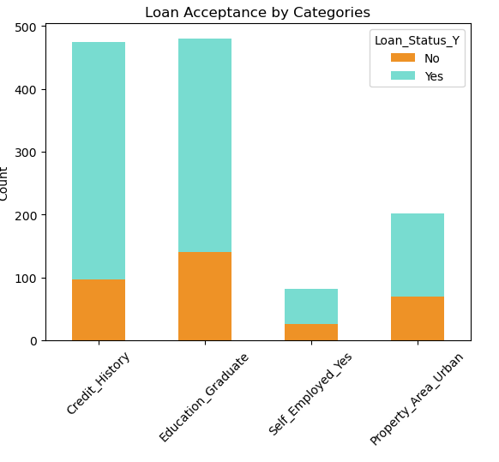
What we selected?
In our project, we selected the AdaBoost (Adaptive Boosting) machine learning model for the mortgage loan approval bot. AdaBoost is a popular ensemble learning method that combines multiple weak learners to create a strong predictive model.

Slide 4
Why we selected?
Accuracy: AdaBoost is known for its high accuracy in classification tasks. By combining multiple weak learners, it can capture complex patterns in the data and make accurate predictions.
Handling Imbalanced Data: Mortgage loan approval datasets often suffer from class imbalance, where the number of approved loans is significantly different from the number of rejected loans. AdaBoost handles imbalanced data well by focusing on the misclassified samples in each boosting round, helping to mitigate the impact of class imbalance.
Robustness to Overfitting: AdaBoost applies a boosting approach that gives more weight to misclassified samples in subsequent iterations. This process helps to reduce overfitting by focusing on the challenging instances during training.
Interpretability: While AdaBoost uses an ensemble of weak learners, it can still provide insights into feature importance. By analyzing the weights assigned to each weak learner and their corresponding features, we can understand the relative importance of different factors in the loan approval process.
Availability and Ease of Use: AdaBoost is a widely implemented algorithm, available in popular machine learning libraries such as scikit-learn. Its straightforward implementation and ease of use make it convenient for our project.

Slide 5
Data preparation and model training process
Obtained the data from Kaggle: The data set is about loan approval status for different customers, including Gender, Marital Status, Education, Number of Dependents, Income, Loan Amount, Credit History and others.
Collected and preprocessed the data: dropping unnecessary columns, encoding categorical variables, handling missing values, and scaling numerical features.
Model trained using the prepared dataset: splitting of the data into training and testing sets, fitting model using training data, making prediction on testing data, and calculating accuracy score.

Slide 6
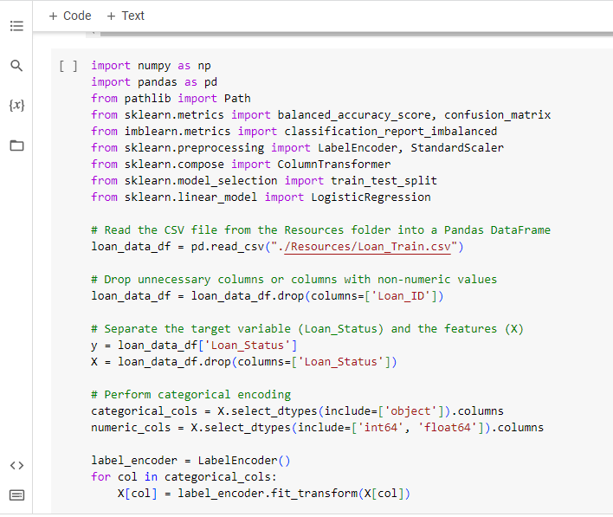
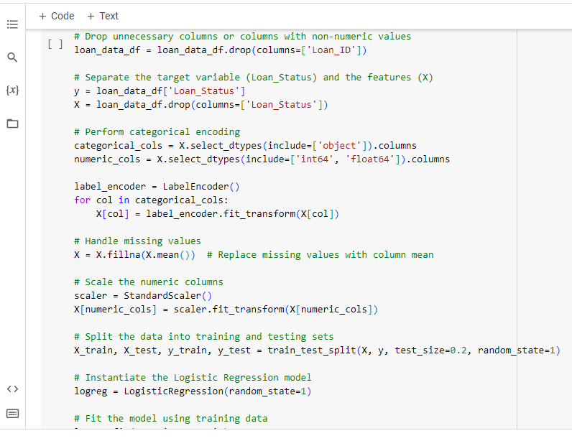
How it works…
1
2

Slide 7
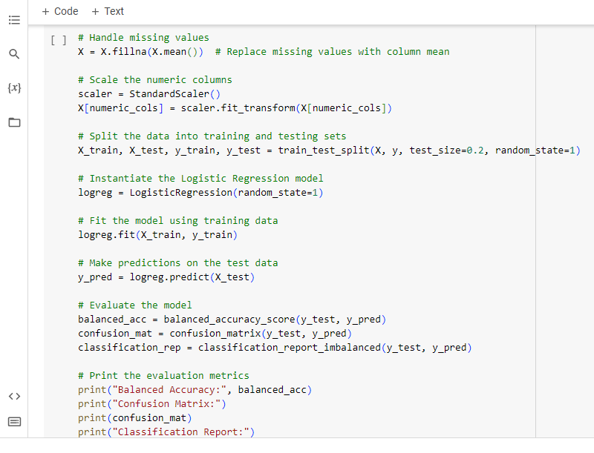
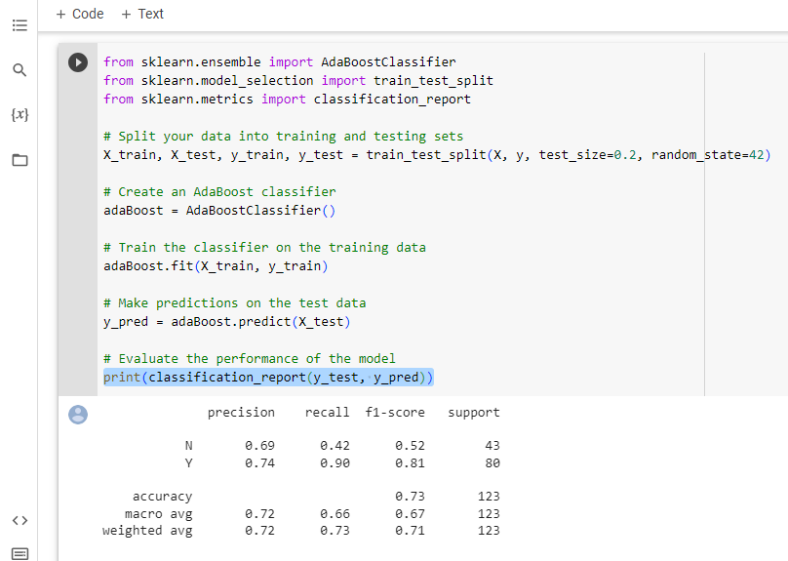
How it works…
3
4

Slide 8
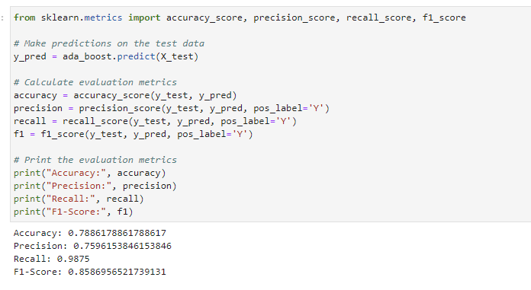
How we evaluate…
Accuracy Score
Precision Score
Recall Score
F1-Score

Slide 9
Challenges
Data Quality Issues: Missing data can significantly impact the performance of machine learning models. We had to decide on appropriate strategies to handle missing values, such as replacing missing values with column mean.
Imbalanced Dataset: The number of approved loans is significantly higher than the rejected loans. Imbalanced data can lead to biased models that favor the majority class. We had to employ the synthetic minority oversampling technique (SMOTE) to address the class imbalance issue and ensure that the model can accurately predict loan approvals for both classes.

Slide 10
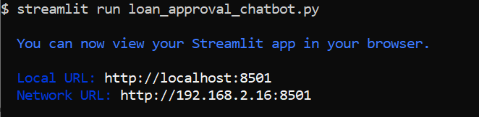
Conclusion
The boosted model demonstrates improved performance compared to the previous model, with higher precision, recall, and F1-score values. This indicates that the model is better at correctly classifying positive samples, while maintaining a reasonable level of correctness and balance between precision and recall.
Based on the boosted model, we figured out the range for an if-else algorithm in Streamlit.

Slide 11
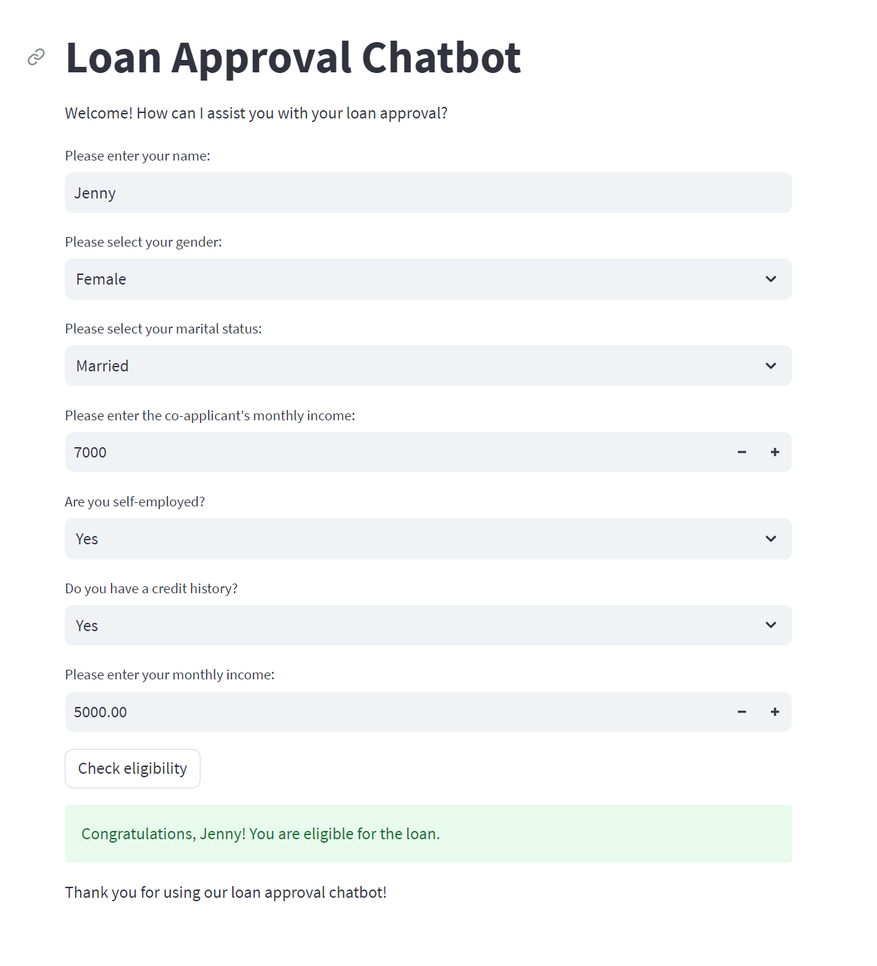
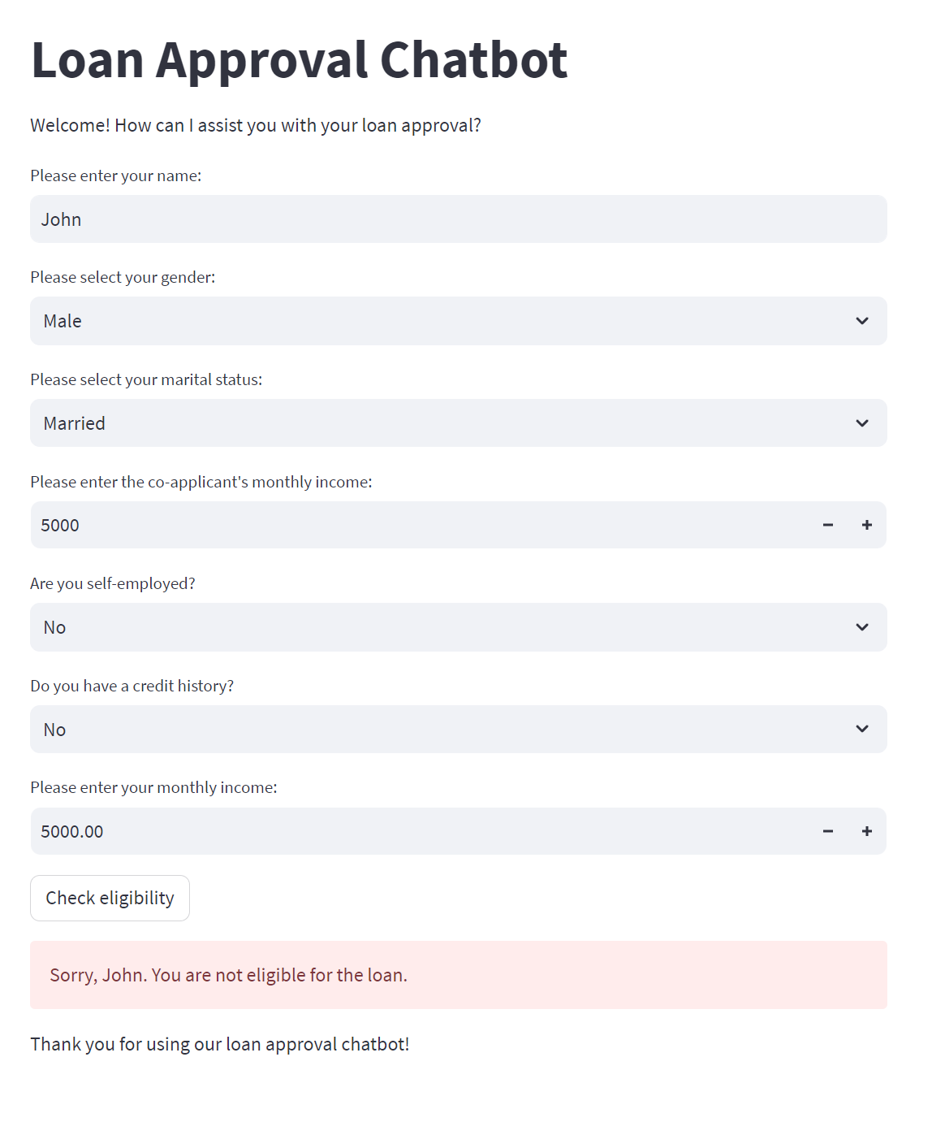
Loan Approval Chatbot

Slide 12
Next Steps
Integrate additional data sources to refine the model
Model fairness – aim to develop models that treat all individuals fairly and make predictions or decisions that are unbiased and unbiased.

Slide 13
Links
Deployed application: http://localhost:8501/#loan-approval-chatbot
GitHub repo: https://github.com/FintechStu23/MortLoanAppBot.git
Thank you!

